Slide 1

Designing websites
Lesson 1: Basic styling using CSS

Slide 2
Objectives
In this lesson, you will learn:
how web pages are defined and displayed
how to change the styling on a web page using CSS
how to use classes to style specific elements.

Slide 3
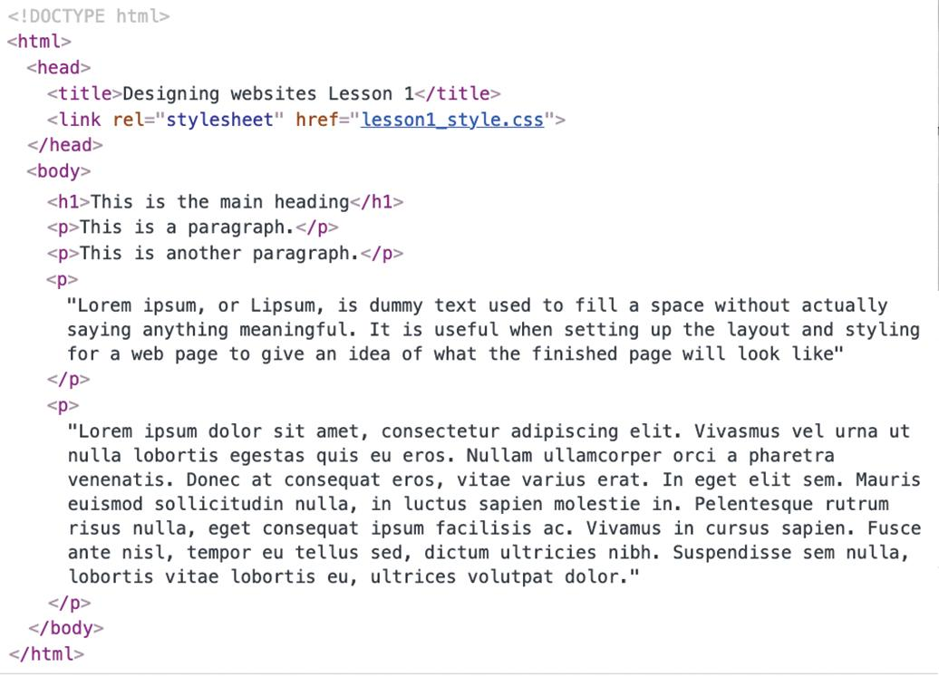
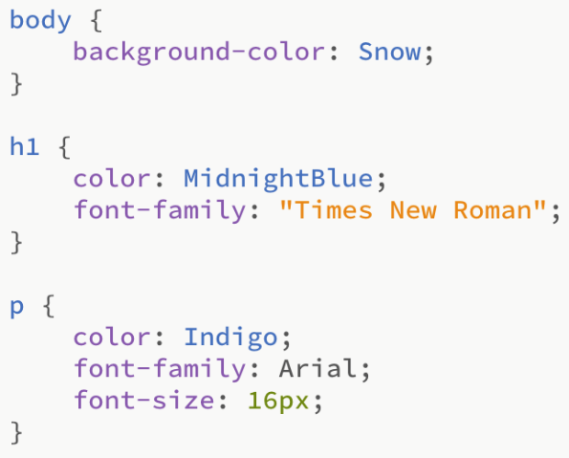
Do you know what this code is used for?

Slide 4
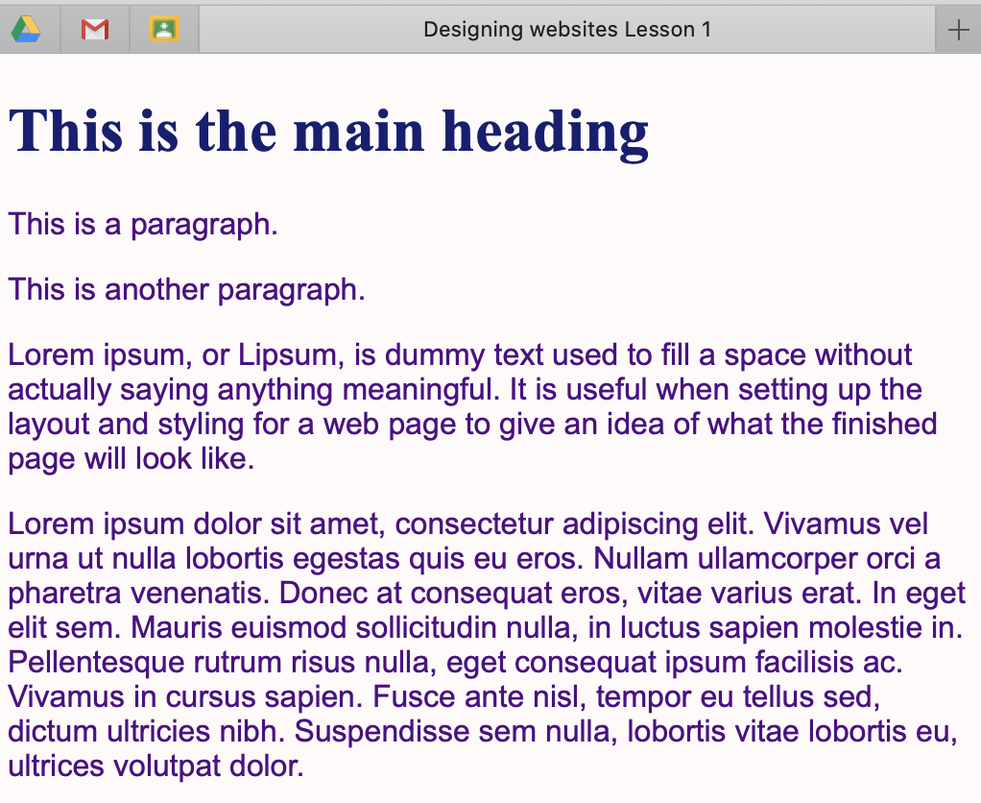
The web page displayed by the code

Slide 5
HTML
Hyper Text Markup Language (HTML) is used to describe the structure of a web page. It consists of a series of elements. These elements label their content as, for example, a heading, a paragraph, an image or a hyperlink, using tags.
An HTML tag is a word or letter surrounded by angle brackets: < and >.
Most elements have an opening tag and a closing tag, with the content placed between the two tags. The closing tag has a forward slash / in front of the word or letter. For example, <p> and </p>.
Browsers, such as Chrome, Edge, Safari and Firefox, use this information to determine how the content should be displayed.
Each page of a website is written as a separate .html document.

Slide 6
CSS
CSS stands for Cascading Style Sheet.
CSS properties are used to format the layout of a web page, including:
the colour of the text
the size of the text
the font used
the background colours and images
how elements are positioned
the spacing between elements.

Slide 7
External CSS
An external style sheet is a single document, saved with a .css extension, that sets out the styling to be used for all the main elements on every page of a website.
Each HTML page includes a link to the external style sheet that it needs to use. For example:
<link rel="stylesheet" href="styles.css">
External style sheets allow you to change the styling of an entire website by editing just one file.

Slide 8
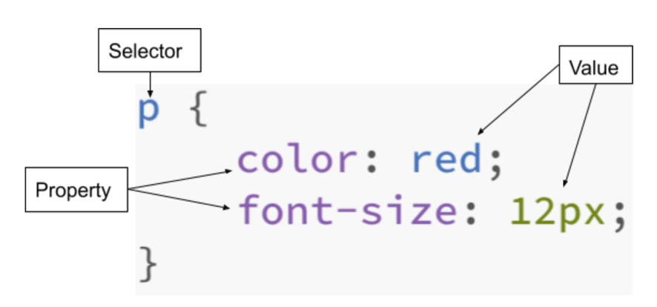
The syntax for CSS rules
A CSS style rule consists of a selector and a declaration block.
The selector indicates which HTML element the styling refers to.
The declaration includes the CSS property name and a value, separated by a colon.
It is possible to have more than one declaration in a block, in which case each declaration is separated using a semicolon. It is usual to put each declaration on a separate line so that it is easy to see which properties have been styled.
The declaration block is surrounded by curly brackets.

Slide 9
Changing the styling
This shows a style sheet with styling for several different aspects of a web page:
Any styling added to the body selector will be applied to the whole web page.
The main heading is defined using the h1 selector, and paragraphs are defined using the p selector.

Slide 10
CSS property names
Text colour
To set the colour of the text we use the property color.
Note that the American spelling is required.
The easiest way to specify a colour is to use its colour name. There are 140 standard colour names and a full list can be found online.
Background colour
To set the background colour we use the property background-color.
Again, the colour name can be used for the value.

Slide 11
CSS property names
Font
To set the font we use the property font-family.
The value is the name of the font that you want to use, such as Arial or Courier New. If the name of the font family has more than one word then it must be put in quotation marks; for example "Times New Roman".
Font size
HTML tags have pre-defined font sizes for six heading levels (h1 to h6) and for the normal text in paragraphs.
To change the size of the font we use the property font-size. The value is, for example, 16px.

Slide 12
Editing and viewing web pages
All the HTML files, the CSS file and any images for a website that you are creating need to be saved to the same folder on your computer.
To edit these files, you will need to use a text editor. Open the editor and then click on 'File', 'Open' to select the file you wish to edit.
To view the web page, double click on the HTML file, or right-click on it and choose 'Open with' and select your browser.
Watch Video 1.1

Slide 13

Activity 1.1: Styling using CSS

Slide 14

CSS classes
So far, we have applied the same styling to all elements on a web page that share the same tag. For example, all of the paragraphs defined by <p> have had the same styling.
However, it is possible to apply different styling to specific HTML elements using the CSS class selector.
The styling is defined in the style sheet with a full stop followed by your chosen class name.
For example:
This will change the text colour of all elements that have been assigned the class black-text to black.

Slide 15

Assigning the class
The class is assigned in the HTML document by adding class= followed by the class name inside quotation marks. For example:
A class can be applied to as many elements in an HTML document as required.
It is also possible to assign more than one class to an HTML element. This is done by placing additional class names inside the quotation marks separated by spaces.
Watch Video 1.2

Slide 16
Activity 1.2: Styling using CSS classes

Slide 17
Activity 1.3: Challenge exercise

Slide 18
Quiz 1

